Slide 1
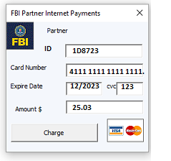
FBI
/* COPYRIGHT */
DEVELOPMENT
WHITE COLAR
11:39 AM April, 28 2023
IBM Tivoli
IBM Rational
IBM WebSphere
IBM MQ
IBM DB2
nonPoliceTestAgent(“Add Windows Application”)
TRUE/FALSE
View(Portlet, Servlet, HTML)
nonPoliceServlet(“/WebService/Add-Windows-Application”)
11:51 AM April, 28 2023
Controller
12:15 AM April, 28 2023
Business Delegate
Service Locator ( MQ, DB2 )
Model
Data Access Object
Factory

Slide 2
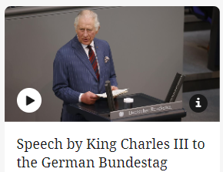
FBI
/* COPYRIGHT */
DEVELOPMENT
HOMICIDE:NANA
1991
NORTH TONBRIDGE, ENGLAND
CHANNEL
1993
SAINT PETER, GERMANY
assumed:
HOMICIDE:KRYSTAL St. Peter HOMICIDE:ur_ur_opi (omi) joes mother ATB.eval
Joes mother believes more in God
Other: that is a nice person

Slide 3
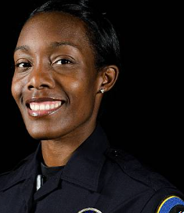
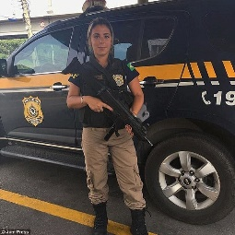
FBI
/* COPYRIGHT */
DEVELOPMENT
HOMICIDE:NANA
short: Apple Inc.
Tim Cook
One Infinite Loop
Cupertino, California
United States of America
LABOR_CODE.nonPolcieBrazilLoagial
HOMICIDE:NANA.nonPoliceSeperation
NAVY.phil.nonPololiceTattoo
Best Regards,
Jason Nygel Meiers
Africa women feeding infant
Brazilen women working for DEA
In the woods

Slide 4
FBI
/* COPYRIGHT */
DEVELOPMENT
WHITE COLAR
11:39 AM April, 28 2023
BUSINESS PROCESS MANAGEMENT

Slide 5
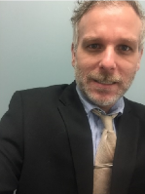
FBI
/* COPYRIGHT */
DEVELOPMENT
HOMICIDE:NANA
WHITE COLAR
LABOR_CODE.nonPoliceBrazilLogical
11:39 AM April, 28 2023
“And then there were all these Brazilian mothers feeding infants”
0.001 nonPoliceContentItem(umpalumpas)
….
….
HOMICIDE:NANA.nonPoliceSeperation
The logical serpation LABOR_CODE Frauenhoffer Institure (MP4,MP3) Framesets in memory

Slide 6
FBI
/* COPYRIGHT */
DEVELOPMENT
WHITE COLAR
11:39 AM April, 28 2023
“And then there were all these Brazilian mothers feeding infants”
0.001 nonPoliceContentItem(umpalumpas)
….
….
HOMICIDE:NANA.nonPoliceSeperation
The logical serpation LABOR_CODE Frauenhoffer Institure (MP4,MP3) Framesets in memory
WWI.GOVOURER.SWAZENEGGER.FBI:KIDDNAPPING:CHECKPOINTCHALIE(twinners).HOMICIDE:SUNSTROKE

Slide 7
FBI
/* COPYRIGHT */
DEVELOPMENT
WHITE COLAR
11:39 AM April, 28 2023
“And then there were all these Brazilian mothers feeding infants”
0.001 nonPoliceContentItem(umpalumpas)
….
….
HOMICIDE:NANA.nonPoliceSeperation
The logical serpation LABOR_CODE Frauenhoffer Institure (MP4,MP3) Framesets in memory
WWI.GOVOURER.SWAZENEGGER.FBI:KIDDNAPPING:CHECKPOINTCHALIE(twinners).HOMICIDE:SUNSTROKE

Slide 8
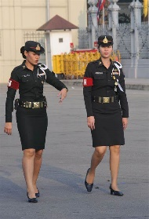

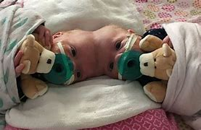
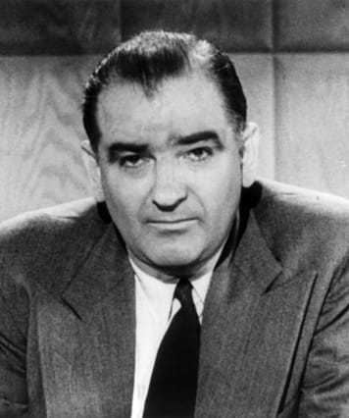
FBI
/* COPYRIGHT */
DEVELOPMENT
WHITE COLAR
11:39 AM April, 28 2023
WWI.GOVOURER.SWAZENEGGER.FBI:KIDDNAPPING:CHECKPOINTCHALIE(twinners).HOMICIDE:SUNSTROKE
JFK
(McCarty Visa ITIL;grey)
MLK(FRAUNHOFFER(MP4)
uuid: Roth.ibm.dmiler.apple.accntuer.touch
41.§187.PREA.CPVA MATHEW: BROTHER
Notes:
The Governor of California Arnold Schwarzenegger in regards to the Brandenburger Tor ( near Checkpont Charlie)
FBI NSA Terrorism Kidnapping and San Quentin Act Prison Rape Elimination Act implementation of NATO,
Bundesverfassungsgericht (trans.) Germany Federal Constitutional Court and US Constitution
with a series for planned (surgenoned; Dr) Architected (of September 11 attacks ) homicides in specific attempts to
King Charles when visiting Marin County, San Quentin and Checkpoint Reyes.
The FBI Kidnapping of Petersson; (1987) Siamese head-connected twins (Pope Mary), twinners t-shirt, simens cats
With Test Agents and Quality Assurance of FBI Kidnapping. Including Auschwitz Test Agent Civil Code Internet Violations
Of Southwest Texas and Germany; Baden-Wuertemberg (cat twins Maincoon); in addition to Homicide networked
Former soviet uion Mannheim based BASF chemicals…

Slide 9

FBI
/* COPYRIGHT */
DEVELOPMENT
WHITE COLAR
11:39 AM April, 28 2023
nonPoliceAuschwitz
Flowers soviet union/
nonPolicePolenLogicakl
FEDERAL VP GERMAY:HOMCIDE:LUX(Goethe)
41.roth.ibm.dmeilr.appl.yahoo.employe.wolfgan.majevski.HOMICE:LUX.§STALKING(ibm.client.wsam.client.walmart)
WWI.GOVOURER.SWAZENEGGER.FBI:KIDDNAPPING:CHECKPOINTCHARLIE(twinners).HOMICIDE:SUNSTROKE
uuid: Roth.ibm.dmiler.apple.accntuer.touch
TWINS
1987 Television 0.1 HOMICIDE:LUX:VHS
1988 MATHEW(magnum; two babies in MP4 odd)
FEDARL CASE bertalman HOMICDE:LUX
1989 Twins HOMCIDE:LUX:IPX.ligustics(viola)
1990 T-Shirt Twinners (12,000 and Michelle)
1994 Pizza(ria) I
Pizza(ria) II
2000 Cats MARY
I put this garb in my head and they attached MARY
Nygel, Jason Meiers
Notes:
The Governor of California Arnold Schwarzenegger in regards to the Brandenburger Tor ( near Checkpont Charlie)
FBI NSA Terrorism Kidnapping and San Quentin Act Prison Rape Elimination Act implementation of NATO,
Bundesverfassungsgericht (trans.) Germany Federal Constitutional Court and US Constitution
with a series for planned (surgenoned; Dr) Architected (of September 11 attacks ) homicides in specific attempts to
King Charles when visiting Marin County, San Quentin and Checkpoint Reyes.
The FBI Kidnapping of Petersson; (1987) Siamese head-connected twins (Pope Mary), twinners t-shirt, simens cats
With Test Agents and Quality Assurance of FBI Kidnapping. Including Auschwitz Test Agent Civil Code Internet Violations
Of Southwest Texas and Germany; Baden-Wuertemberg (cat twins Maincoon); in addition to Homicide networked
Former soviet uion Mannheim based BASF chemicals…

Slide 10

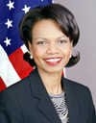
FBI
/* COPYRIGHT */
DEVELOPMENT
COUNTERINTELLIGENCE
01:15 AM April, 15 2023
I will call you Dr. Rice from
The Constitutional Court in
Federal Republic of Germany (US)
And the US Embassy in Frankfurt

Slide 11

FBI
/* COPYRIGHT */
DEVELOPMENT
COUNTERINTELLIGENCE
01:15 AM April, 15 2023
I will call you Dr. Rice from
The Constitutional Court in
Federal Republic of Germany (US)
And the US Embassy in Frankfurt
CIA case officer Visa McCarty brothers spied for the Russians for nearly a decade before his arrest in 1994.
TWINS
Kollja Reiss was convicted of perjury in 2010, following a lengthy espionage investigation by the FBI and its partners.
Whitehouse Terrorist club pled guilty in 2000 to passing U.S. secrets to Germany and United States
Kinderdisko CVPA; Child Pornogphy Victus Assistnace

Slide 12
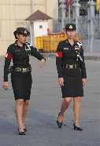
FBI
/* COPYRIGHT */
DEVELOPMENT
COUNTERINTELLIGENCE
01:15 AM April, 15 2023
I will call you Dr. Rice from
The Constitutional Court in
Federal Republic of Germany (US)
And the US Embassy in Frankfurt
CIA case officer Visa McCarty brothers spied for the Russians for nearly a decade before his arrest in 1994.
TWINS

Slide 13

FBI
/* COPYRIGHT */
DEVELOPMENT
WHITE COLAR
11:39 AM April, 28 2023
BUSINESS PROCESS MANAGEMENT
PRESIDENT
Hambleton reads: MATHEW:Twins
Santa Clara County, California
1987 Foster City, California
1988 University Davis, California
1990 -2023 Hambleton reads; knows removing MATHEW (twins)
marx

